Slide 1
NODE JS

Slide 2
Know Your Trainer
Mujib ur Rahman (aka Mujib)
5 Years of experience in product development
.Net and Javascript developer
www.ngblog.in
Codeproject articles
Youtube courses
https://www.youtube.com/playlist?list=PLJvlF1Rakz9c3p8BrxxKIahtJ7EHq4njs
https://www.youtube.com/playlist?list=PLJvlF1Rakz9fYEeDhOLaECkov6pUDRvyg

Slide 3
AGENDA
Multi client service oriented architecture
NodeJs
Node http server

Slide 4


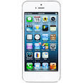
MULTI CLIENT SERVICE ORIENTED ARCHITECTURE
Api/products/get
Controllers
BL Layer
List<Products>
Repository
Database
REST Api

Slide 5
NODEJS
Javascript run time
To create server side applications
Runs on a single thread
Uses chrome’s V8 javascript engine
200k node packages to serve almost every purpose
Fast, non blocking

Slide 6
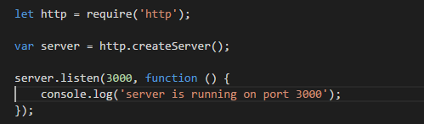
CREATING HTTP SERVER
Import http module
Call create server method of http module
Start listening on a port

Slide 7
SUMMARY
Multi client service oriented architecture
Introduction to NodeJs
Creating http server

